Slide 1
Curriculum Learning for Language Modeling
Daniel Campos
CLMS Thesis
Oct 30th, 2020

Slide 2
Agenda
Definition/Background
Motivation
Experiment Design
Evaluation Metrics
Results
Discussion
Future Work

Slide 3
What is Language Modeling/Context Dependent Word Representations
A method for representing words and sentences in a context dependent fashion
e.g. understanding that there is a different meaning of fly for:
You look fly.
That is a fly.
Let us fly away.
Representations are usually trained by learning to model language
P(Y|X) where Y is the next word and X is all the words before it
Changed the NLP is done with continually improving frameworks inspired by Muppets
ELMO
BERT
ERNIE
CoVE
GPT and GPT-2
RoBERTa
Turing NLR

Slide 4
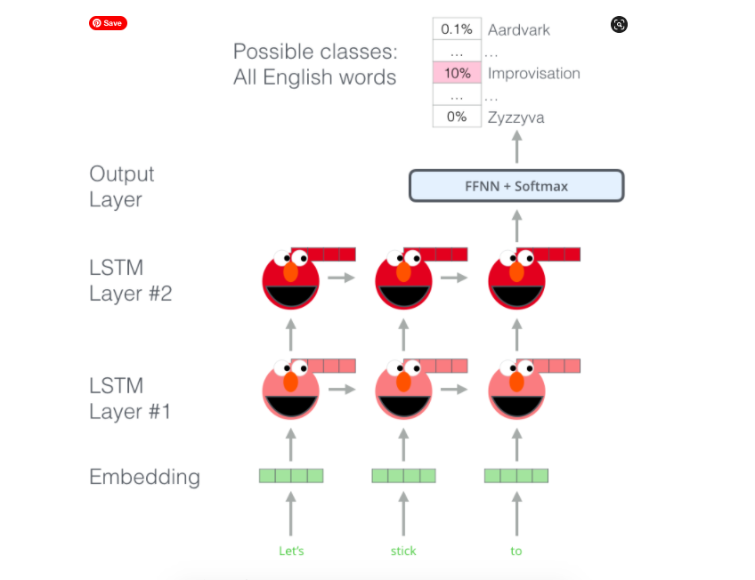
What is ELMO
Released 2018
Stacked BiLSTMs
Trained with P(Y|X) and P(X|Y)
Next word and previous word prediction
Trained on billion word corpus
3 weeks 1080ti GPU
10 Epochs

Slide 5
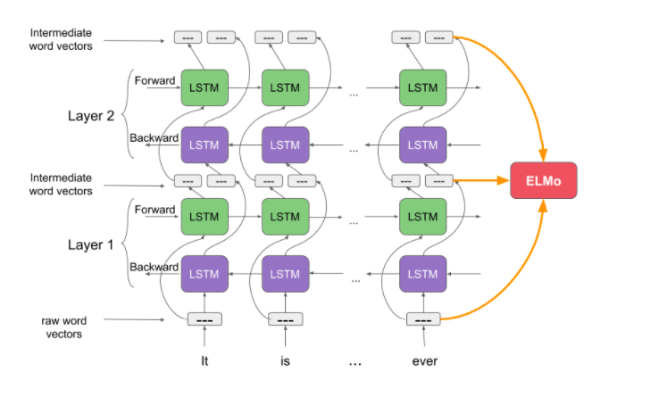
What is ELMO Continues

Slide 6
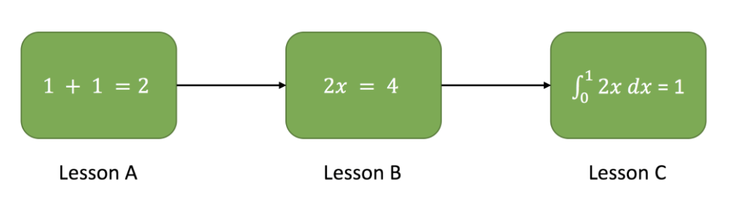
What is Curriculum Learning
A method for adding some kind of structure to the training regime of a neural network.
Introduced by Bengio(formally in 2009)
Grounded in human learning where people learn better if they see easy examples first and move onto hard examples

Slide 7
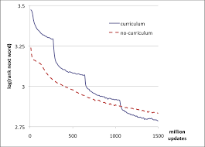
Curriculum Learning For Language Modeling
Take a corpus and set a threshold where you set any word that is not in the N most common words to <unk>
Experiments with the Wikipedia corpus (631m words)
Start with a low value for N(5,000) and after each pass on the entire dataset increase N by 5000.
Eventually the model trains on the entire corpus
Model trained with curriculum learning achieves a lower loss on the held out portion than non curriculum model

Slide 8
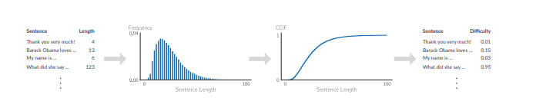
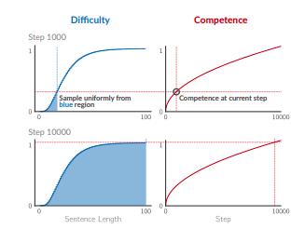
Competence Based Curriculum Learning
Method for curriculum learning pioneered in NMT.
Implementation is simple
Look over your dataset and with some heuristic assign a notion of difficulty to each sample
Length
Unigram
Using this notion of difficulty sort the samples from easiest to hardest and use a Cumulative Density Function to assign values from 0 to 1
Effectively sorted dataset from easiest to hardest.
To Train the NN assign a competence to the learner(How much of the dataset they can learn from)
For each step in an epoch
Sample a batch randomly from all samples that are easier than model’s current competence.
Increase model;s competence by Ω until model is able to train on entire corpus.
Once model is competent train on full dataset for M more minibatches.

Slide 9
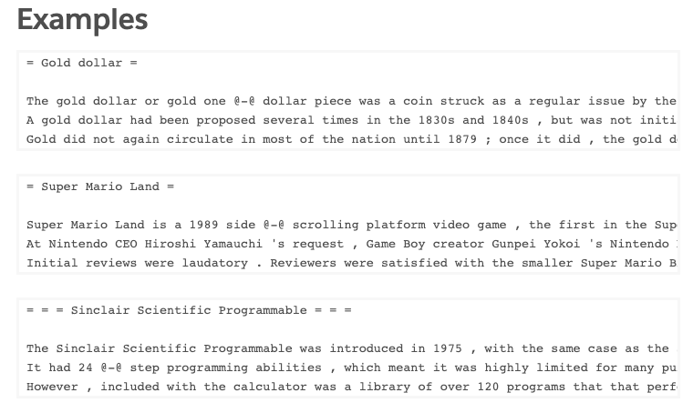
Wikitext Dataset
The WikiText language modeling dataset is a collection of over 100 million tokens extracted from the set of verified Good and Featured articles on Wikipedia.
The dataset is available under the Creative Commons Attribution-ShareAlike License.

Slide 10

GLUE
The General Language Understanding Evaluation (GLUE) benchmark is a collection of resources for training, evaluating, and analyzing natural language understanding systems.
GLUE consists of:A benchmark of nine sentence- or sentence-pair language understanding tasks built on established existing datasets and selected to cover a diverse range of dataset sizes, text genres, and degrees of difficulty and a diagnostic dataset designed to evaluate and analyze model performance with respect to a wide range of linguistic phenomena found in natural language.

Slide 11
Motivation
Language Modeling has been super successful, but training is inefficient.
Curriculums learning has shown to improve performance in Computer Vision, Reinforcement Learning, and some parts of NLP. Will similar findings hold in NLP?
Does using some linguistically driven curriculums help form a more robust context dependent word representation?

Slide 12
Experiment Design
Chose a LM method to explore based on speed on experimentation cycles and previous impact
Use ELMO because it was SOTA at some point and model training is relatively fast compared to BERT.
ELMO trains for 10 epochs on their dataset so we will match that
All other hyperparameters are kept constant
Explore Effect of Competence curricula and traditional curricula
Traditional curricula train 5 epochs with expanding vocabulary and then 5 on full corpus
Competence based curricula where 6.6 epochs to full competence and 3.3 on full corpus
7 competence curricula
Baseline(full competence entire time)
Unigram probability
Bigram Probability
Trigram Probability
Dependency Parse Depth
POS Diversity
Random Curricula
Take corpuses of 2 different sizes and see how curricula methods effect model performance
Wikitext-2 and wikitext-103. Wikitext-2 is a subset of wikitext-103 but 50x smaller.
Make a sentence-based corpus as ELMO is sentence based Explore traditional curricula methods(Bengio model) and competence curricula
Sentence split using spacy.io
4 corpuses to train and evaluate on.
Introduce a padding token <PAD> to deal with sentences and lines shorter than context window(20 tokens)
Set loss of <PAD> to 0

Slide 13
Experiment Design Continued
Evaluate system GLUE
Use Jiant Library to standardize training/evaluation
ELMO is used as input
Evaluate on perplexity on validation portion of train dataset
Every 100 batches
Evaluate on perplexity each epoch to understand if curriculum methods learn better.
At the end of experiment evaluate on all validation set(2 corpus size, line and sentence level)

Slide 14
Experiment Continued
In total train ELMO 32 different ways and then GLUE on all and compare to public released ELMO
4 2080ti ubuntu server
103 corpus takes ~2 days per curricula
2 corpus takes ~1/8 day
GLUE finetune and eval is ~1.5 day
Total time
(Train 103 + Train 2 + FineTune Glue)*Error Factor
(2*16 + 1/8 * 16 + 32*1.5) *1.2= (32 + 4 + 48 )*1.2= 84*1.2 = ~100 days!
Not as efficient as I would have liked ☹

Slide 15
Questions Before I show you a bunch of Data?

Slide 16
Bengio Curricula(Validation Perplexity)
Curricula method performs slightly worse until has access to full corpus.
Then Curricula performs slightly worse

Slide 17
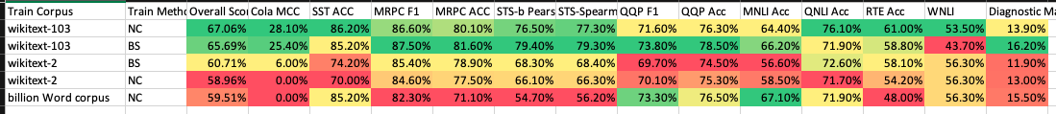
Bengio Curricula GLUE
Surprisingly the original ELMO model does quite badly
On small corpus the Bengio Style curricula does slightly better but as the corpus scales the Bengio method proves less effective.
On Large corpus the non curricula method outperforms curricula method but mostly because the Bengio method WNLI accuracy is nearly 10 points lower
There are outliers on specific tasks. The Bengio method 103 out performs every other(not just those listed here) on Diagnostic main.

Slide 18
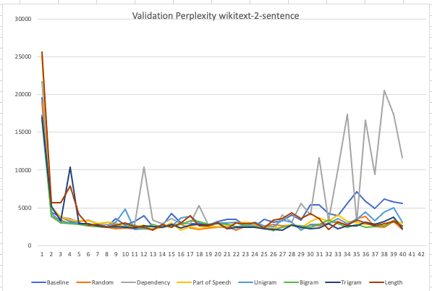
Competence Validation wikitext-2-sentence
Same trend as other corpuses: Random and POS are best. Unlike other corpuses DEP(overfit) does badly.
Similar to 103 curricula method perplexity in 100s instead of baseline 150.

Slide 19
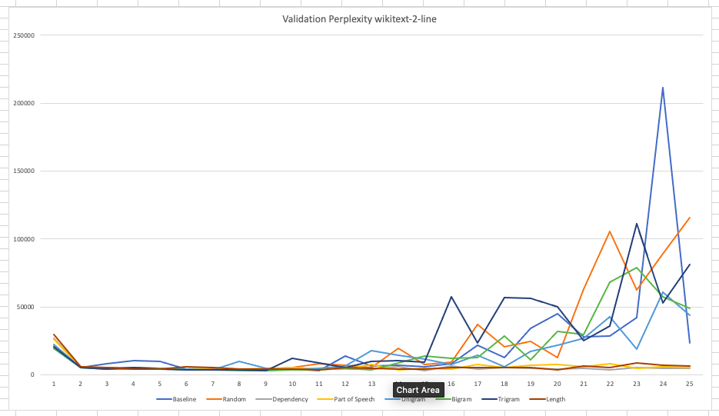
Competence Validation wikitext-2-line
POS, Dep and Length show best performance
N-gram methods have exploding perplexity.
Best perplexity still not even close to non curricula methods

Slide 20
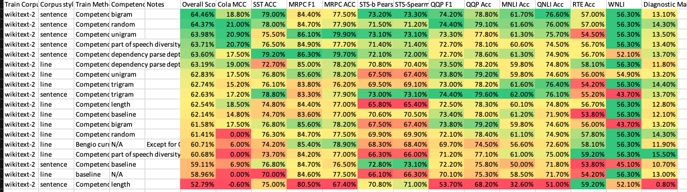
GLUE Wiki-2
Baseline method does second worse!
Sentence based method seems to do better across the board
Random curricula is second best.

Slide 21
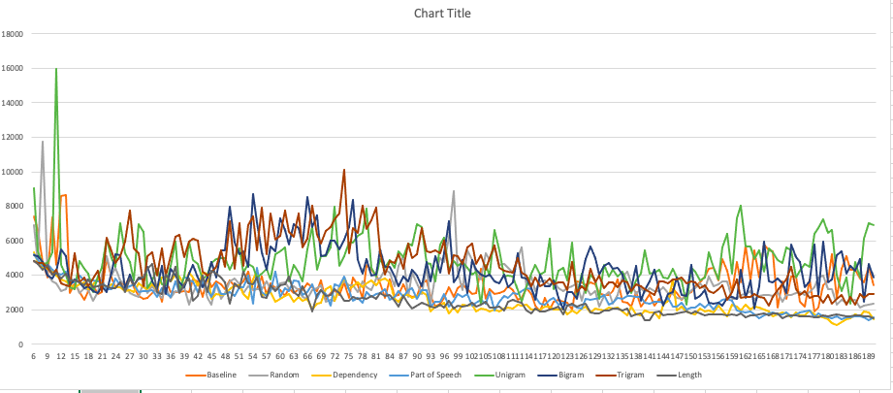
Competence Validation wikitext-103-sentence
Lowest Perplexity is Dependency Parse followed by POS and then random curricula.
Curricula methods never drop beneath 1000 perplexity while baseline method is ~36.

Slide 22
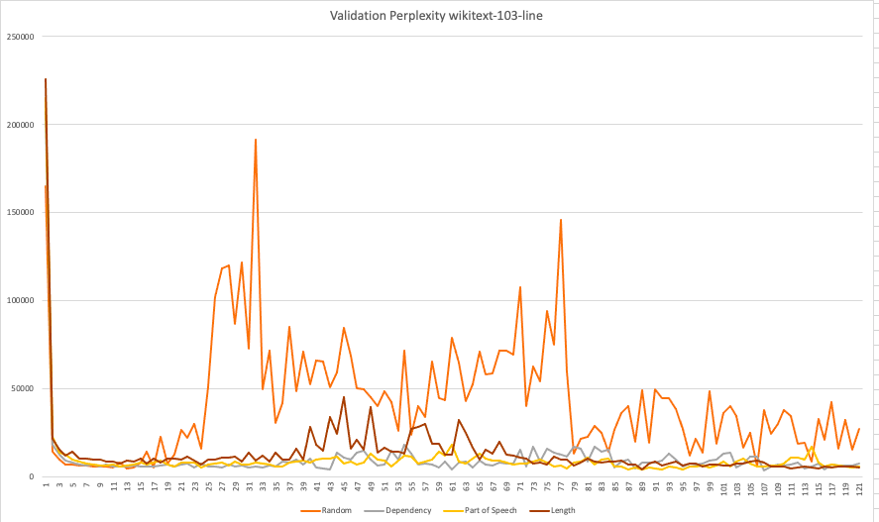
Competence Validation wikitext-103-line
Unigram, Bigram and trigram(not show) overfit and perplexity was through the roof
Much like sentence Dependency parse, POS, and random perform best but still way off the baseline

Slide 23
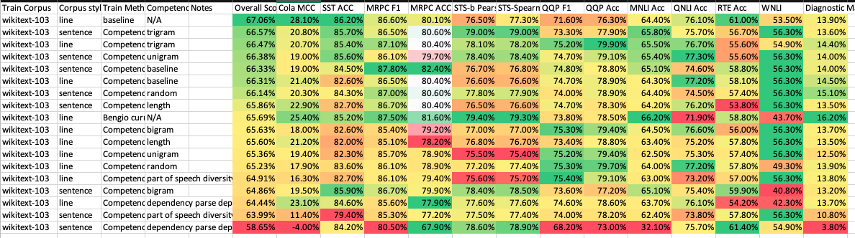
GLUE Wikitext-103
Regular implementation out performs every method
Of the curriculum methods Trigram curricula generate best representation
No clear effect of sentences vs lines
Methods with lowest perplexity on validation != best methods with GLUE

Slide 24
Analysis
On small corpuses curricula show improvement vs regular random implementation.
No clear winner in curricula. Random curricula seem to work pretty well
On large corpus curricula implementation does worse. Perhaps as corpus scales and training time scales notion of structure is no longer useful in training
Harder examples when the LR is low?

Slide 25
Future Work
Move over training focus on pruning and quantization
Can we make the already trained model smaller and run better?
Lot of support from CV world but not as clear in transfer learning
What about multi task learning?

Slide 26
Comments and Questions? Discussion?

